Slide 1

INFO16529: Week 2
Risk Management

Slide 2
Topics
Introduction to Risk Management
3 Major Processes of Risk Management…
Risk Identification
Risk Assessment
Risk Control

Slide 3
Terminology
Organizations must design and create safe environments in which business processes and procedures can function
Risk
A risk is the potential negative impact a threat can have on an environment.
Risk is ultimately assigned a $$$$ value

Slide 4
Risk Management
The process of risk management is the process of determining:
Which risks should be addressed and
How they should be addressed

Slide 5
Risk Management
One seldom can control all risks, though within reason, a company should do what it can to limit their risk and this is true with IT Security.
“It’s all about trade-offs”— where does a company invest its $$$?

Slide 6
Risk Management
Three (3) major processes:
Risk Identification
Risk Assessment
Risk Control

Slide 7
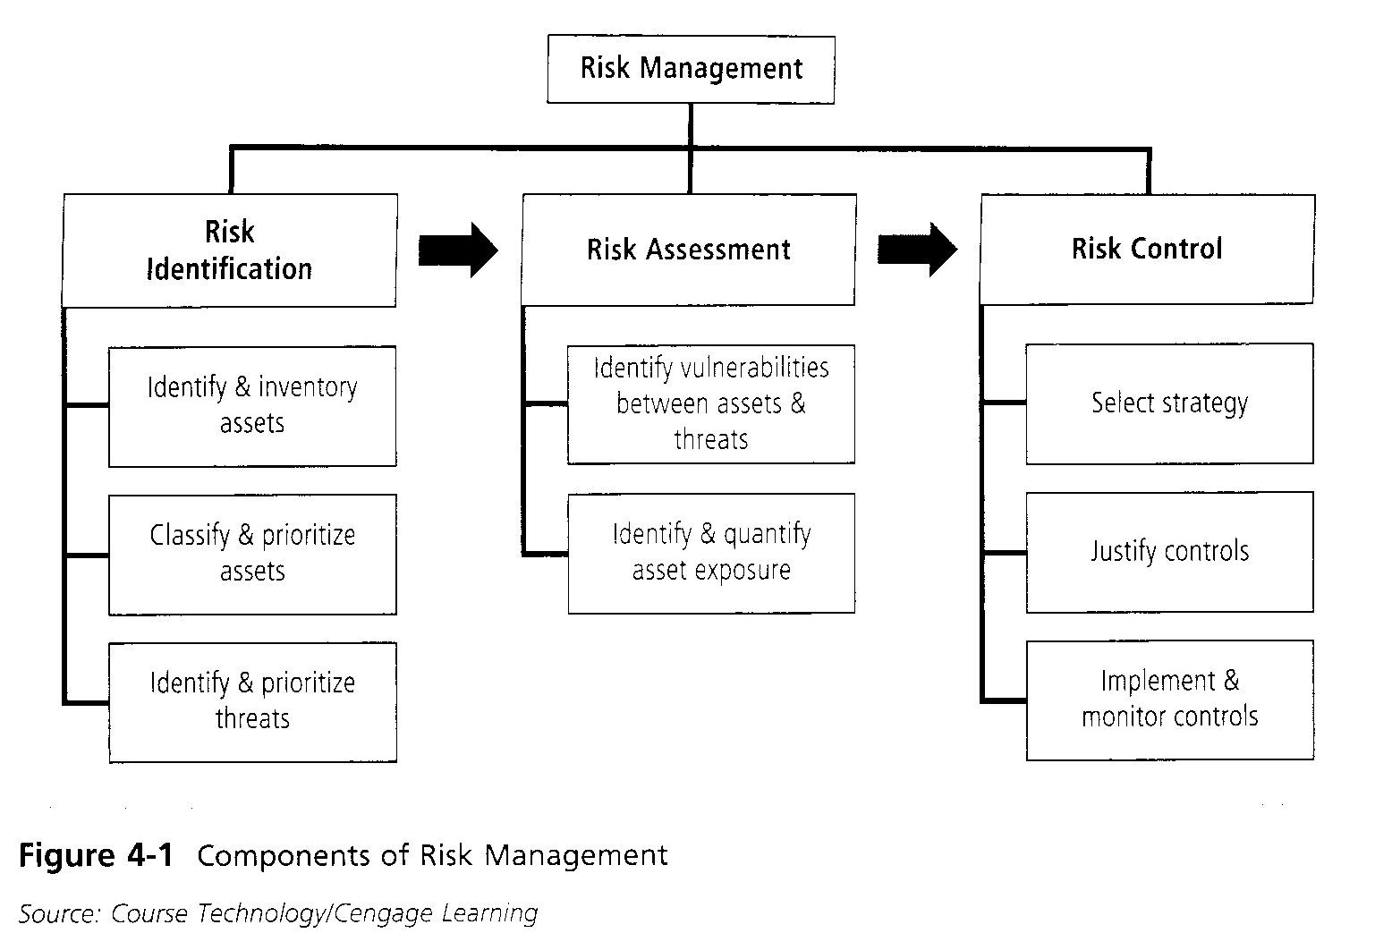
Risk Management

Slide 8
Risk Identification: Assets
What are the assets?
Identify Assets and Inventory
People, procedures and data
HW, SW, and Network
Value
Prioritize

Slide 9
Example: Lab room
What are the assets in the Lab room?
What are the likely value of the assets?
How would you prioritize the assets?

Slide 10

Notes:
The picture is taken from:https://labfurnishing.com/how-to-choose-the-best-computer-lab-furniture

Slide 11
Example: Lab room
What are the assets in the Lab room?
What are the likely value of the assets?
How would you prioritize the assets?

Slide 12
Risk Identification: Vulnerabilities
Determine the vulnerabilities
For each information asset
Determine for each threat a list of vulnerabilities

Slide 13
Example: Lab room
What are the vulnerabilities of the assets in the Lab room?

Slide 14
Risk Identification: Threats
Identify threats
Prioritize threats

Slide 15
Example: Lab room
What are the threats to the Lab room?
How would you prioritize the threats?

Slide 16
Risk Management

Slide 17
Risk Assessment
How significant are the risks to the organization?
Starting point:
List of Assets, Asset value and Asset priority
List of threats and threat priority
List of vulnerability of each asset

Slide 18
Risk Assessment
There are a number of different risk assessment calculations as you will have noted from the text books
Today, I mention one quantitative approach and one qualitative approach.

Slide 19
Risk Assessment
Risk =
Threat
+
Likelihood
+
Impact

Slide 20
Risk Assessment
Risk =
Threat itself
Likelihood of the threat happening (per year)
Impact on organization should the threat happen

Slide 21
Risk
Threat: Data loss
Vulnerability: Server failure due to power outage
Likelihood / year: 50%
Potential Impact: $1000
ALE (Annual Loss Expectancy): $500

Slide 22
Risk
Threat: Data loss
Vulnerability: Server failure
Likelihood / year: 50%
Potential Impact: $1000
ALE (Annual Loss Expectancy): $500

Slide 23
Risk
Ultimately, the question you ask is:
Are you spending more money securing the asset annually than you could reasonably expect to lose?

Slide 24
Likelihood?
The obvious question is, “Where does the likelihood come from?”
Research
Historical data (E.g. How many power outages in last few years? Sources of outages?)
Government, meteorological, geographical data (e.g. Theft statistics, storms, earthquakes, etc.)

Slide 25
Qualitative Approach
Scales such as high/medium/low are used
Numbers are often assigned to each rating so that a numeric value can be calculated for comparison.

Slide 26
Qualitative Issues
What does each mean? (e.g. How frequent is “Very frequent”)
How valid is your differentiation?
Numeric | Frequency | Impact
6 | Constant | Extremely High
5 | Very frequently | Very high
And so on...

Slide 27
Risk Management

Slide 28
Risk Control
Sometimes called the “Risk Mitigation Strategy”
Goal: Control the “Risks”
The use of controls (countermeasures) reduce risk to an organization’s data and information systems.

Slide 29
Risk Control
There are five strategies:
Defend
Transfer
Mitigate
Accept
Terminate

Slide 30
Risk Control: Defend
Sometimes called “reduction” or “limitation”
Goal is to prevent the exploitation of a vulnerability
Three common methods used:
Policy
Education and Training
Technology
Most common strategy

Slide 31
Risk Control: Defend
Examples:
Software updates
Monitoring server logs
Fire drills
Cross training of staff

Slide 32
Risk Control: Transfer
Goal: shifting the cost or responsibility of the risk to other assets, processes, organizations
Handing off the risk to a 3rd party
On-going cost

Slide 33
Risk Control: Transfer
The organization may then transfer the risk associated with management of complex systems to another organization experienced in dealing with those risks.
Examples:
Insurance
Hosting
Out-sourcing

Slide 34
Risk Control: Mitigate
Goal: reduce the impact caused by the exploitation of a vulnerability
Incident Response Plan
Disaster Recovery Plan
Business Continuity Plan

Slide 35
Risk Control: Accept
Do Nothing!
“Doing nothing” is a decision!
A company may be willing to accept a risk
Least $$$ of all the strategies

Slide 36
Risk Control: Accept
Reasons are numerous:
Risk management options are more costly than risk
Perceived low chance of risk

Slide 37
Risk Control: Accept
“Doing nothing” could be cheap before the attack
Cost could be higher than other strategies after the event

Slide 38
Risk Control: Terminate
Also called Avoidance, avoid the risk.
Opposite of Acceptance
Avoid ANY exposure to the risk
Most expensive of all strategies

Slide 39
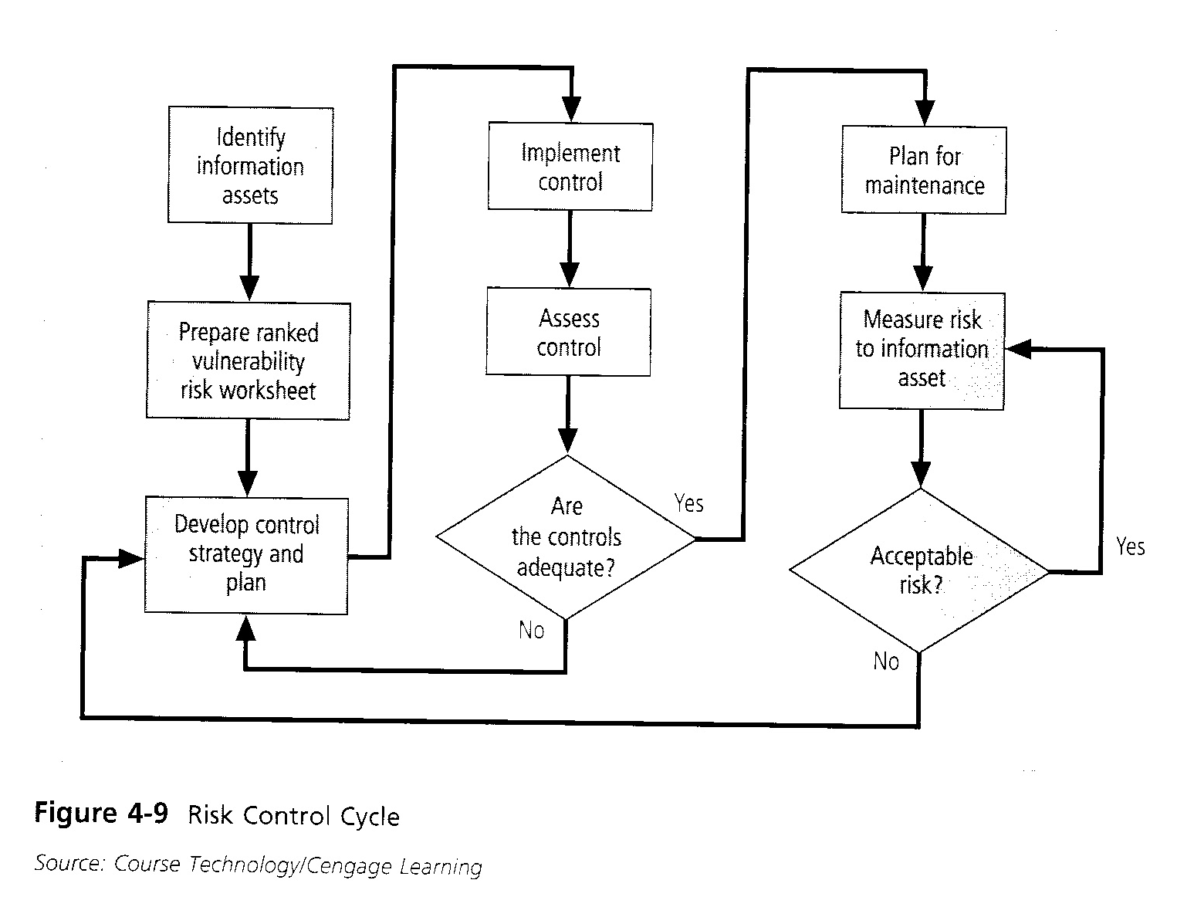
Risk Control Cycle
Notes:
The thing you should focus on this diagram are the parts from “Implement Control” to “Measure Risk to Asset”
Notice how the control is not just implemented and left. It is assessed to ensure it reduces the risk as planned. Also, maintenance is part of the cycle.

Slide 40
Summary
Introduction to Risk Management
3 Major Processes of Risk Management…
Risk Identification
Risk Assessment
Risk Control: Defend, Transfer, Mitigate, Accept, Terminate

